Slide 1
CS 168 More Congestion Control
Fall 2015
Scott Shenker
http://inst.eecs.berkeley.edu/~cs168/fa15/

Slide 2

Ssssshhhhhhhhhhhhhhh

Slide 3
Announcements
OH after class: going over midterm in Soda 420
No discussion of regrades
Just reviewing solutions to problems
Attendance on Thursday was very light
Will repeat part of the lecture so that today’s is understandable to everyone
My apologies for not posting slides today….

Slide 4
Absolute Silence!

Slide 5
Leo P. Kadanoff (1937-2015)
Notes:
Think: basic concepts
Research: any means necessary
Care: about everything

Slide 6
Why AIMD?
In what follows refer to cwnd in units of MSS

Slide 7
Reality Of Congestion Control
1Gbps
1Gbps
600Mbps
Congestion control is a resource allocation problem involving many flows, many links, and complicated global dynamics

Slide 8
Problem is too complicated….
Goal:
Avoid overloading links, but don’t waste bandwidth
Must do so in the presence of
Many competing flows
Dynamic conditions (flows arriving, leaving)
Complicated topology
Limited visibility
How do you think about such a problem?

Slide 9
Modularity is not just for design….
It is a lesson in how to think!
Break problems into subproblems
Gain insight into the subproblems,
And hope that union solves real problem

Slide 10
Three Congestion Control Challenges
Single flow adjusting to bottleneck bandwidth
Without any a priori knowledge
Could be a Gbps link; could be a modem
Single flow adjusting to variations in bandwidth
When bandwidth decreases, must lower sending rate
When bandwidth increases, must increase sending rate
Multiple flows sharing the bandwidth
Must avoid overloading network
And share bandwidth “fairly” among the flows

Slide 11
Abstract View
Ignore internal structure of router and model it as a single queue for a particular input-output pair
A
B
Sending Host
Buffer in Router
Receiving Host

Slide 12
1. Discovering available bandwidth
Pick sending rate to match bottleneck bandwidth
Without any a priori knowledge
Could be gigabit link, could be a modem
A
100 Mbps
B

Slide 13
2. Adjusting to varying bandwidth
Adjust rate to match instantaneous bandwidth
Assuming you have rough idea of bandwidth
BW(t)
A
B

Slide 14
3. Multiple flows sharing bandwidth
Two Issues:
Adjust total sending rate to match bandwidth
Allocation of bandwidth between flows
A1
B1
A2
BW(t)
B2
A3
B3

Slide 15
Problem #1: Single Flow, Fixed BW
Slow start is pretty good at this….
...no need to discuss further

Slide 16
Problem #2: Single Flow, Varying BW
Want to track available bandwidth
Oscillate around its current value
If you never send more than your current rate, you won’t know if more bandwidth is available
Possible variations: (in terms of change per RTT)
Multiplicative increase or decrease:
cwnd → cwnd * / a
Additive increase or decrease:
cwnd → cwnd +- b

Slide 17
Four alternatives
AIAD: gentle increase, gentle decrease
AIMD: gentle increase, drastic decrease
MIAD: drastic increase, gentle decrease
too many losses: eliminate
MIMD: drastic increase and decrease
Notes:
What do you think about these options?
Which one is obviously bad?
What do you think about the other ones?

Slide 18
Problem #3: Multiple Flows
Want steady state to be “fair”
Many notions of fairness, but here just require two identical flows to end up with the same bandwidth
This eliminates MIMD and AIAD
As we shall see…
AIMD is the only remaining solution!
Not really, but close enough….

Slide 19
Buffer and Window Dynamics
A
B
x
C = 50 pkts/RTT
No congestion → x increases
Congestion → x decreases

Slide 20
Simple Model of Congestion Control
Two users
rates x₁ and x₂
Congestion when x₁+x₂ > 1
Unused capacity when x₁+x₂ < 1
Fair when x₁ =x₂
1
Efficiency line (x₁+x₂ = 1)
Fairness line (x₁ =x₂)
User 2’s rate (x₂)
congested →
← inefficient
User 1’s rate (x₁)
1

Slide 21
Example
1
fairness
line
Efficient: x₁+x₂=1
Fair
Congested: x₁+x₂=1.2
(0.7, 0.5)
User 2: x₂
(0.2, 0.5)
(0.5, 0.5)
congested →
Inefficient: x₁+x₂=0.7
(0.7, 0.3)
← inefficient
Efficient: x₁+x₂=1
Not fair
efficiency
line
User 1: x₁
1

Slide 22
AIAD
Increase: x + a_{I}
Decrease: x - a_{D}
Does not converge to fairness
fairness
line
(x₁-a_{D}+a_{I}), x₂-a_{D}+a_{I}))
(x₁,x₂)
User 2: x₂
(x₁-a_{D},x₂-a_{D})
congested →
← inefficient
efficiency
line
User 1: x₁

Slide 23
AIAD Sharing Dynamics
x₁
A
B
x₂
D
E

Slide 24
MIMD
Increase: x*b_{I}
Decrease: x*b_{D}
Does not converge to fairness
fairness
line
(x₁,x₂)
(b_{I}b_{D}x₁, b_{I}b_{D}x₂)
User 2: x₂
(b_{d}x₁,b_{d}x₂)
congested →
← inefficient
efficiency
line
User 1: x₁

Slide 25
MIMD Sharing Dynamics
x₁
A
B
x₂
D
E

Slide 26
AIMD
Increase: x+a_{I}
Decrease: x*b_{D}
Converges to fairness
fairness
line
(x₁,x₂)
(b_{D}x₁+a_{I}, b_{D}x₂+a_{I})
User 2: x₂
(b_{D}x₁,b_{D}x₂)
congested →
← inefficient
efficiency
line
User 1: x₁

Slide 27
AIMD Sharing Dynamics
x₁
A
B
x₂
50 pkts/sec
D
E
Rates equalize → fair share

Slide 28
Answer to Why AIMD?
AIMD is only reasonable choice that is “fair”
Out of the four options
AIAD, MIMD: not fair
MIAD: too much congestion
AIMD: fair and reasonable congestion

Slide 29
Any Questions?

Slide 30
TCP Congestion Control Details
In what follows refer to cwnd in units of MSS

Slide 31
Implementation
State at sender
CWND (initialized to a small constant)
ssthresh (initialized to a large constant)
[Also dupACKcount and timer, as before]
Events
ACK (new data)
dupACK (duplicate ACK for old data)
Timeout

Slide 32
Event: ACK (new data)
If CWND < ssthresh
CWND += 1
CWND packets per RTT
Hence after one RTT with no drops: CWND = 2xCWND

Slide 33
Event: ACK (new data)
If CWND < ssthresh
CWND += 1
Else
CWND = CWND + 1/CWND
Slow start phase
“Congestion Avoidance” phase (additive increase)
CWND packets per RTT
Hence after one RTT with no drops: CWND = CWND + 1

Slide 34
Event: TimeOut
On Timeout
ssthresh ← CWND/2
CWND ← 1

Slide 35
Event: dupACK
dupACKcount ++
If dupACKcount = 3 /* fast retransmit */
ssthresh = CWND/2
CWND = CWND/2
Remains in congestion
avoidance after fast retransmission…

Slide 36
Repeating Slow Start After Timeout
Window
Timeout
SSThresh
Set to Here
Fast Retransmission
Slow start in operation until it reaches half of previous CWND, I.e., SSTHRESH
t
Slow-start restart: Go back to CWND of 1 MSS, but take advantage of knowing the previous value of CWND.

Slide 37
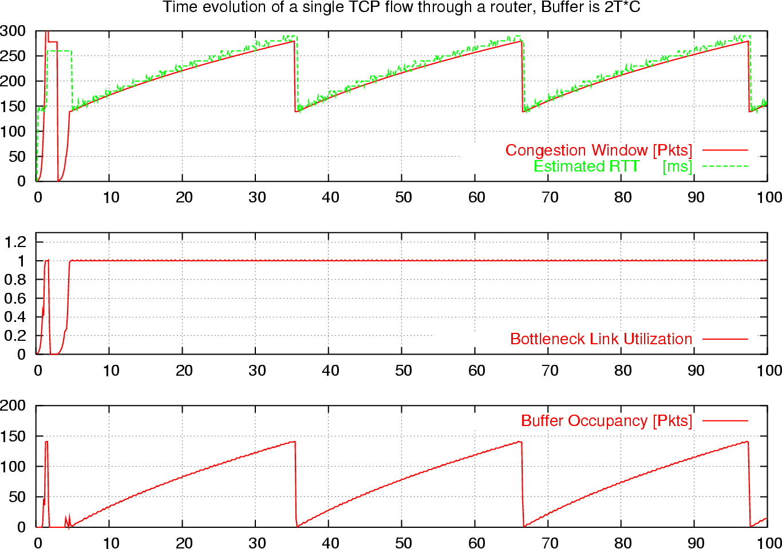
What is really looks like…
Notes:
Why?????

Slide 38
One Final Phase: Fast Recovery
The problem: congestion avoidance too slow in recovering from an isolated loss

Slide 39
Example
Consider a TCP connection with:
CWND=10 packets
Last ACK was for packet # 101
i.e., receiver expecting next packet to have seq. no. 101
10 packets [101, 102, 103,…, 110] are in flight
Packet 101 is dropped
What ACKs do they generate?
And how does the sender respond?

Slide 40
Timeline
ACK 101 (due to 102) cwnd=10 dupACK#1 (no xmit)
ACK 101 (due to 103) cwnd=10 dupACK#2 (no xmit)
ACK 101 (due to 104) cwnd=10 dupACK#3 (no xmit)
RETRANSMIT 101 ssthresh=5 cwnd= 5
ACK 101 (due to 105) cwnd=5 (no xmit)
ACK 101 (due to 106) cwnd=5 (no xmit)
ACK 101 (due to 107) cwnd=5 (no xmit)
ACK 101 (due to 108) cwnd=5 (no xmit)
ACK 101 (due to 109) cwnd=5 (no xmit)
ACK 101 (due to 110) cwnd=5 (no xmit)
ACK 111 (due to 101) ⬅ only now can we transmit new packets
Plus no packets in flight so no ACKs for another RTT

Slide 41
Solution: Fast Recovery
Idea: Grant the sender temporary “credit” for each dupACK so as to keep packets in flight
If dupACKcount = 3
ssthresh = cwnd/2
cwnd = ssthresh + 3
While in fast recovery
cwnd = cwnd + 1 for each additional duplicate ACK
Exit fast recovery after receiving new ACK
set cwnd = ssthresh

Slide 42
Example
Consider a TCP connection with:
CWND=10 packets
Last ACK was for packet # 101
i.e., receiver expecting next packet to have seq. no. 101
10 packets [101, 102, 103,…, 110] are in flight
Packet 101 is dropped

Slide 43
Timeline
ACK 101 (due to 102) cwnd=10 dup#1
ACK 101 (due to 103) cwnd=10 dup#2
ACK 101 (due to 104) cwnd=10 dup#3
REXMIT 101 ssthresh=5 cwnd= 8 (5+3)
ACK 101 (due to 105) cwnd= 9 (no xmit)
ACK 101 (due to 106) cwnd=10 (no xmit)
ACK 101 (due to 107) cwnd=11 (xmit 111)
ACK 101 (due to 108) cwnd=12 (xmit 112)
ACK 101 (due to 109) cwnd=13 (xmit 113)
ACK 101 (due to 110) cwnd=14 (xmit 114)
ACK 111 (due to 101) cwnd = 5 (xmit 115) ⬅ exiting fast recovery
Packets 111-114 already in flight (and now sending 115)
ACK 112 (due to 111) cwnd = 5 + 1/5 ← back in congestion avoidance

Slide 44
TCP State Machine
timeout
slow start
congstn. avoid.
new ACK
dupACK
cwnd > ssthresh
timeout
dupACK
new ACK
timeout
new ACK
dupACK=3
dupACK=3
fast recovery
dupACK

Slide 45
TCP State Machine
timeout
slow start
congstn. avoid.
new ACK
dupACK
cwnd > ssthresh
timeout
dupACK
new ACK
timeout
new ACK
dupACK=3
dupACK=3
fast recovery
dupACK

Slide 46
TCP State Machine
timeout
slow start
congstn. avoid.
new ACK
dupACK
cwnd > ssthresh
timeout
dupACK
new ACK
timeout
new ACK
dupACK=3
dupACK=3
fast recovery
dupACK

Slide 47
TCP State Machine
timeout
slow start
congstn. avoid.
new ACK
dupACK
cwnd > ssthresh
timeout
dupACK
new ACK
timeout
new ACK
dupACK=3
dupACK=3
fast recovery
dupACK

Slide 48
TCP Flavors
TCP-Tahoe
CWND =1 on triple dupACK
TCP-Reno
CWND =1 on timeout
CWND = CWND/2 on triple dupack
TCP-newReno
TCP-Reno + improved fast recovery
TCP-SACK
incorporates selective acknowledgements
Our default assumption

Slide 49
Interoperability
How can all these algorithms coexist? Don’t we need a single, uniform standard?
What happens if I’m using Reno and you are using Tahoe, and we try to communicate?

Slide 50
Any Questions?

Slide 51
TCP Throughput Equation

Slide 52
A Simple Model for TCP Throughput
cwnd
Loss
½ W_{max} RTTs between drops
A
Avg. ¾ W_{max} packets per RTTs
1
time
RTT

Slide 53
A Simple Model for TCP Throughput
cwnd
Loss
½ W_{max} RTTs between drops
A
Avg. ¾ W_{max} packets per RTTs
time

Slide 54
A Critical Analysis of TCP

Slide 55
The Many Failings of TCP CC
Fills up queues (large delays)
Depends on losses (noncongestive losses)
Does not scale to high-speed
Produces irregular saw-tooth behavior
Depends on RTT (unfair)
Takes a long time to reach steady state
Easy to cheat
Relies on homogeneity for performance/fairness

Slide 56
Fixing TCP’s Problems
Solve one of them (and don’t take the easy ones!)
Talk to your neighbors

